Slide 1


ML/DL for Everyone with
Lecture 7:
Wide & Deep

Slide 2
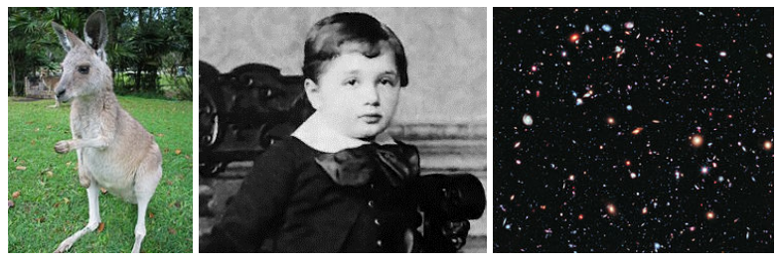
Toward Deep Learning Face recognization
Notes:
\begin{bmatrix}
a_{1} & b_{1} \\
a_{2} & b_{2} \\
a_{3} & b_{3} \\
\hdotsfor{2} \\
a_{n} & b_{n}
\end{bmatrix}
\begin{bmatrix}
w_1 \\ w_2 \\
\end{bmatrix}
=
\begin{bmatrix}
y_{1} \\
y_{2} \\
y_{3} \\
\hdotsfor{1} \\
y_{n}
\end{bmatrix}

Slide 3
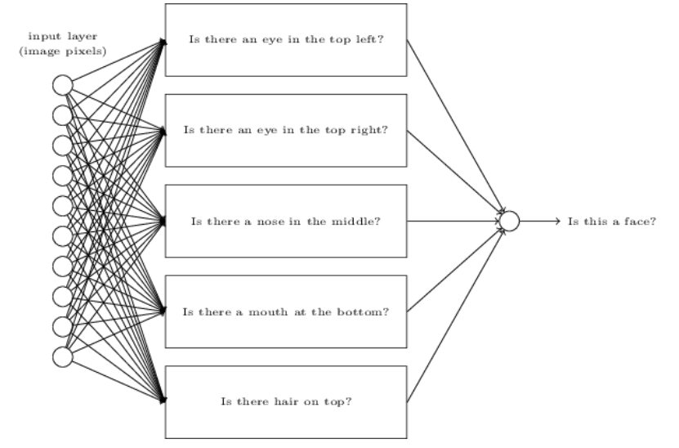
Toward Deep Learning Face recognization
Notes:
\begin{bmatrix}
a_{1} & b_{1} \\
a_{2} & b_{2} \\
a_{3} & b_{3} \\
\hdotsfor{2} \\
a_{n} & b_{n}
\end{bmatrix}
\begin{bmatrix}
w_1 \\ w_2 \\
\end{bmatrix}
=
\begin{bmatrix}
y_{1} \\
y_{2} \\
y_{3} \\
\hdotsfor{1} \\
y_{n}
\end{bmatrix}

Slide 4
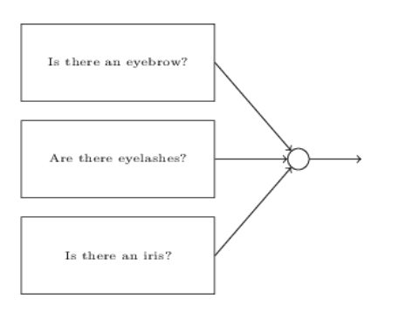
Toward Deep Learning Face recognization
Notes:
\begin{bmatrix}
a_{1} & b_{1} \\
a_{2} & b_{2} \\
a_{3} & b_{3} \\
\hdotsfor{2} \\
a_{n} & b_{n}
\end{bmatrix}
\begin{bmatrix}
w_1 \\ w_2 \\
\end{bmatrix}
=
\begin{bmatrix}
y_{1} \\
y_{2} \\
y_{3} \\
\hdotsfor{1} \\
y_{n}
\end{bmatrix}

Slide 5
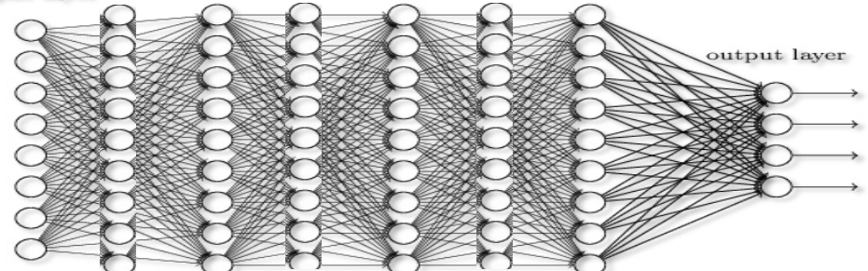
Toward Deep Learning Layers to represent features
Notes:
\begin{bmatrix}
a_{1} & b_{1} \\
a_{2} & b_{2} \\
a_{3} & b_{3} \\
\hdotsfor{2} \\
a_{n} & b_{n}
\end{bmatrix}
\begin{bmatrix}
w_1 \\ w_2 \\
\end{bmatrix}
=
\begin{bmatrix}
y_{1} \\
y_{2} \\
y_{3} \\
\hdotsfor{1} \\
y_{n}
\end{bmatrix}

Slide 6


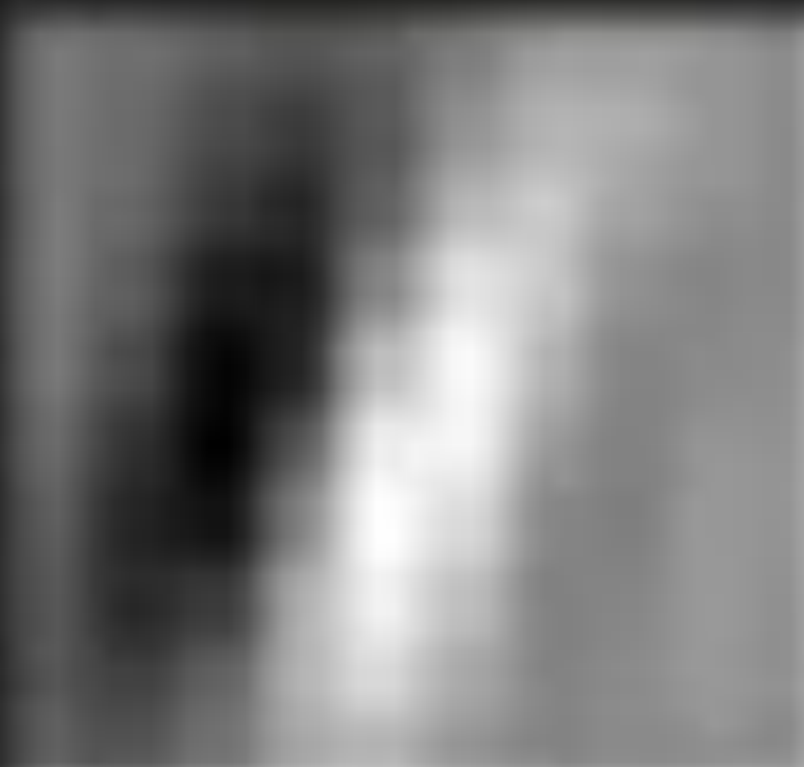
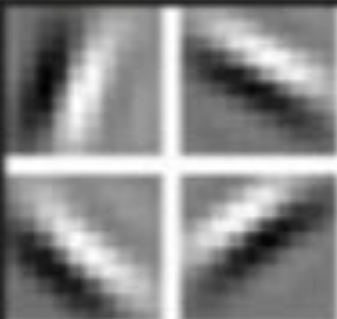
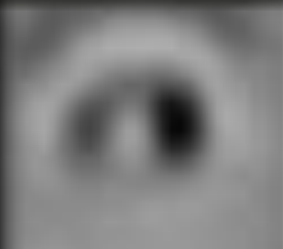
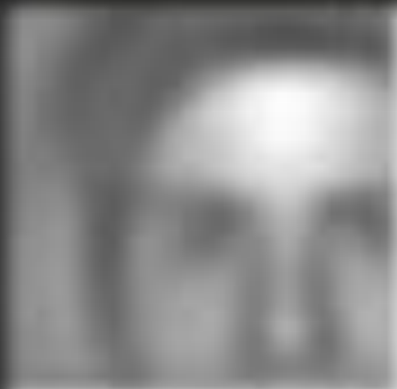
Toward Deep Learning Layers to represent features
Single pixel
Pixels
Lines
Shapes
Objects
Face
Notes:
\begin{bmatrix}
a_{1} & b_{1} \\
a_{2} & b_{2} \\
a_{3} & b_{3} \\
\hdotsfor{2} \\
a_{n} & b_{n}
\end{bmatrix}
\begin{bmatrix}
w_1 \\ w_2 \\
\end{bmatrix}
=
\begin{bmatrix}
y_{1} \\
y_{2} \\
y_{3} \\
\hdotsfor{1} \\
y_{n}
\end{bmatrix}

Slide 7
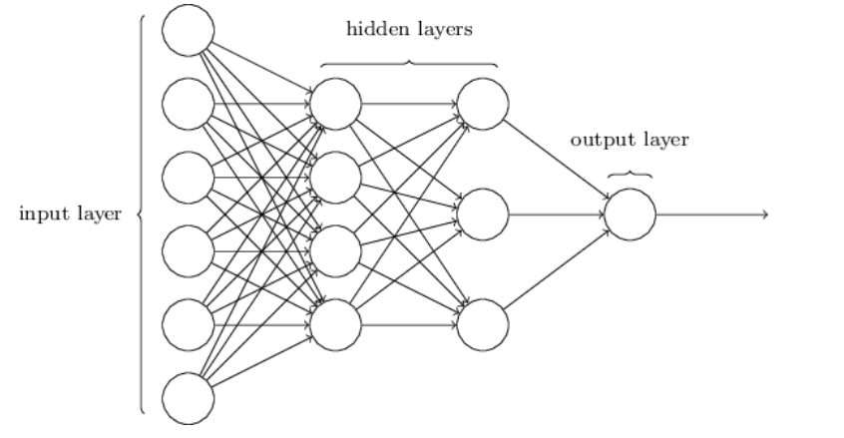
Structure of a deep nn

Slide 8
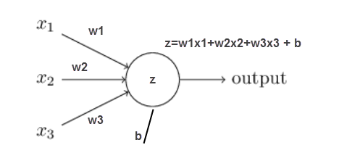
For every neuron

Slide 9
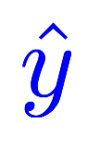
PHD Program Application
GPA (a) | Admission?
2.1 | 0
4.2 | 1
3.1 | 0
3.3 | 1
Linear
Sigmoid
x_data =[[2.1],
[4.2],
[3.1],
[3.3]]
y_data =[[0.0],
[1.0],
[0.0],
[1.0]]

Slide 10
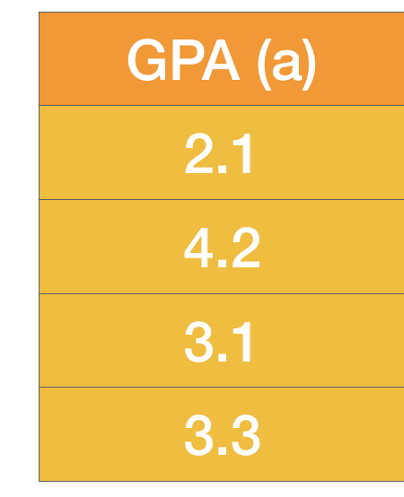
GPA enough?
How about experience and others?
Experience (b) | Admission?
0.1 | 0
0.8 | 1
0.9 | 0
0.2 | 1
Linear
Sigmoid
x_data =[[2.1, 0.1],
[4.2, 0.8],
[3.1, 0.9],
[3.3, 0.2]]
y_data =[[0.0],
[1.0],
[0.0],
[1.0]]

Slide 11
Matrix Multiplication
x_data =[[2.1, 0.1],
[4.2, 0.8],
[3.1, 0.9],
[3.3, 0.2]]
y_data =[[0.0],
[1.0],
[0.0],
[1.0]]
Linear
Sigmoid
Notes:
\begin{bmatrix}
a_{1} & b_{1} \\
a_{2} & b_{2} \\
a_{3} & b_{3} \\
\hdotsfor{2} \\
a_{n} & b_{n}
\end{bmatrix}
\begin{bmatrix}
w_1 \\ w_2 \\
\end{bmatrix}
=
\begin{bmatrix}
y_{1} \\
y_{2} \\
y_{3} \\
\hdotsfor{1} \\
y_{n}
\end{bmatrix}

Slide 12
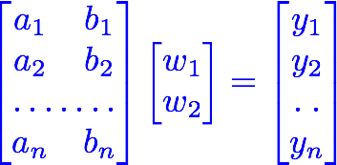

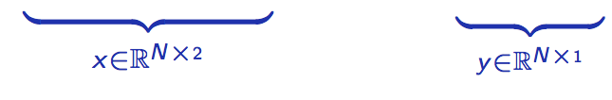
Matrix Multiplication
x_data =[[2.1, 0.1],
[4.2, 0.8],
[3.1, 0.9],
[3.3, 0.2]]
y_data =[[0.0],
[1.0],
[0.0],
[1.0]]
Linear
Sigmoid
Notes:
\begin{bmatrix}
a_{1} & b_{1} \\
a_{2} & b_{2} \\
a_{3} & b_{3} \\
\hdotsfor{2} \\
a_{n} & b_{n}
\end{bmatrix}
\begin{bmatrix}
w_1 \\ w_2 \\
\end{bmatrix}
=
\begin{bmatrix}
y_{1} \\
y_{2} \\
y_{3} \\
\hdotsfor{1} \\
y_{n}
\end{bmatrix}

Slide 13


Matrix Multiplication
x_data =[[2.1, 0.1],
[4.2, 0.8],
[3.1, 0.9],
[3.3, 0.2]]
y_data =[[0.0],
[1.0],
[0.0],
[1.0]]
Linear
Sigmoid
Notes:
\begin{bmatrix}
a_{1} & b_{1} \\
a_{2} & b_{2} \\
a_{3} & b_{3} \\
\hdotsfor{2} \\
a_{n} & b_{n}
\end{bmatrix}
\begin{bmatrix}
w_1 \\ w_2 \\
\end{bmatrix}
=
\begin{bmatrix}
y_{1} \\
y_{2} \\
y_{3} \\
\hdotsfor{1} \\
y_{n}
\end{bmatrix}

Slide 14
Matrix Multiplication
x_data =[[2.1, 0.1],
[4.2, 0.8],
[3.1, 0.9],
[3.3, 0.2]]
y_data =[[0.0],
[1.0],
[0.0],
[1.0]]
Linear
Sigmoid
linear = torch.nn.Linear(2, 1)
y_prd = linear(x_data)
Notes:
\begin{bmatrix}
a_{1} & b_{1} \\
a_{2} & b_{2} \\
a_{3} & b_{3} \\
\hdotsfor{2} \\
a_{n} & b_{n}
\end{bmatrix}
\begin{bmatrix}
w_1 \\ w_2 \\
\end{bmatrix}
=
\begin{bmatrix}
y_{1} \\
y_{2} \\
y_{3} \\
\hdotsfor{1} \\
y_{n}
\end{bmatrix}

Slide 15
Go Wide!
Linear
Sigmoid
…
Linear
Sigmoid

Slide 16
Go Deep!
Linear
Sigmoid

Slide 17
Go Deep!
Linear
Sigmoid
Linear
Sigmoid
Linear
Sigmoid
…
sigmoid = torch.nn.Sigmoid()
l1 = torch.nn.Linear(2, 4)
l2 = torch.nn.Linear(4, 3)
l3 = torch.nn.Linear(3, 1)
out1 = sigmoid(l1(x_data))
out2 = sigmoid(l2(out1))
y_pred = sigmoid(l3(out2)

Slide 18

Sigmoid Activation Functions
Linear
Sigmoid

Slide 19
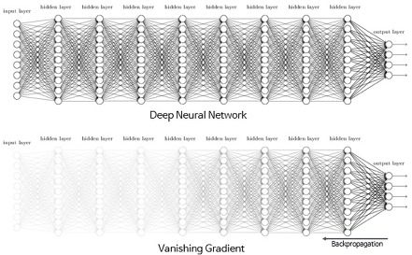
Sigmoid: Vanishing Gradient Problem
Linear
Sigmoid
http://excelsior-cjh.tistory.com/entry/RNN-LSTMLong-Short-Term-Memory-networks

Slide 20
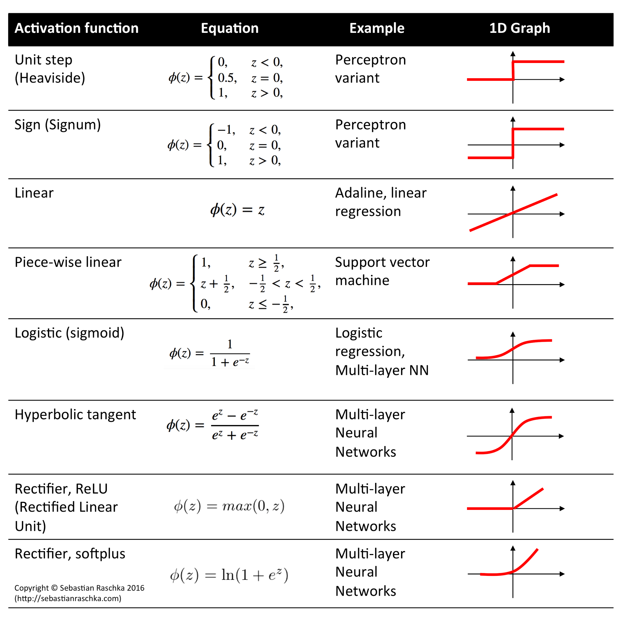
Activation Functions
Linear
Activation
http://rasbt.github.io/mlxtend/user_guide/general_concepts/activation-functions/

Slide 21

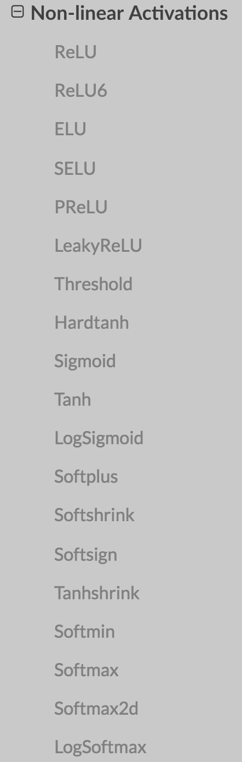
Activation Functions
Linear
Activation
http://rasbt.github.io/mlxtend/user_guide/general_concepts/activation-functions/

Slide 22
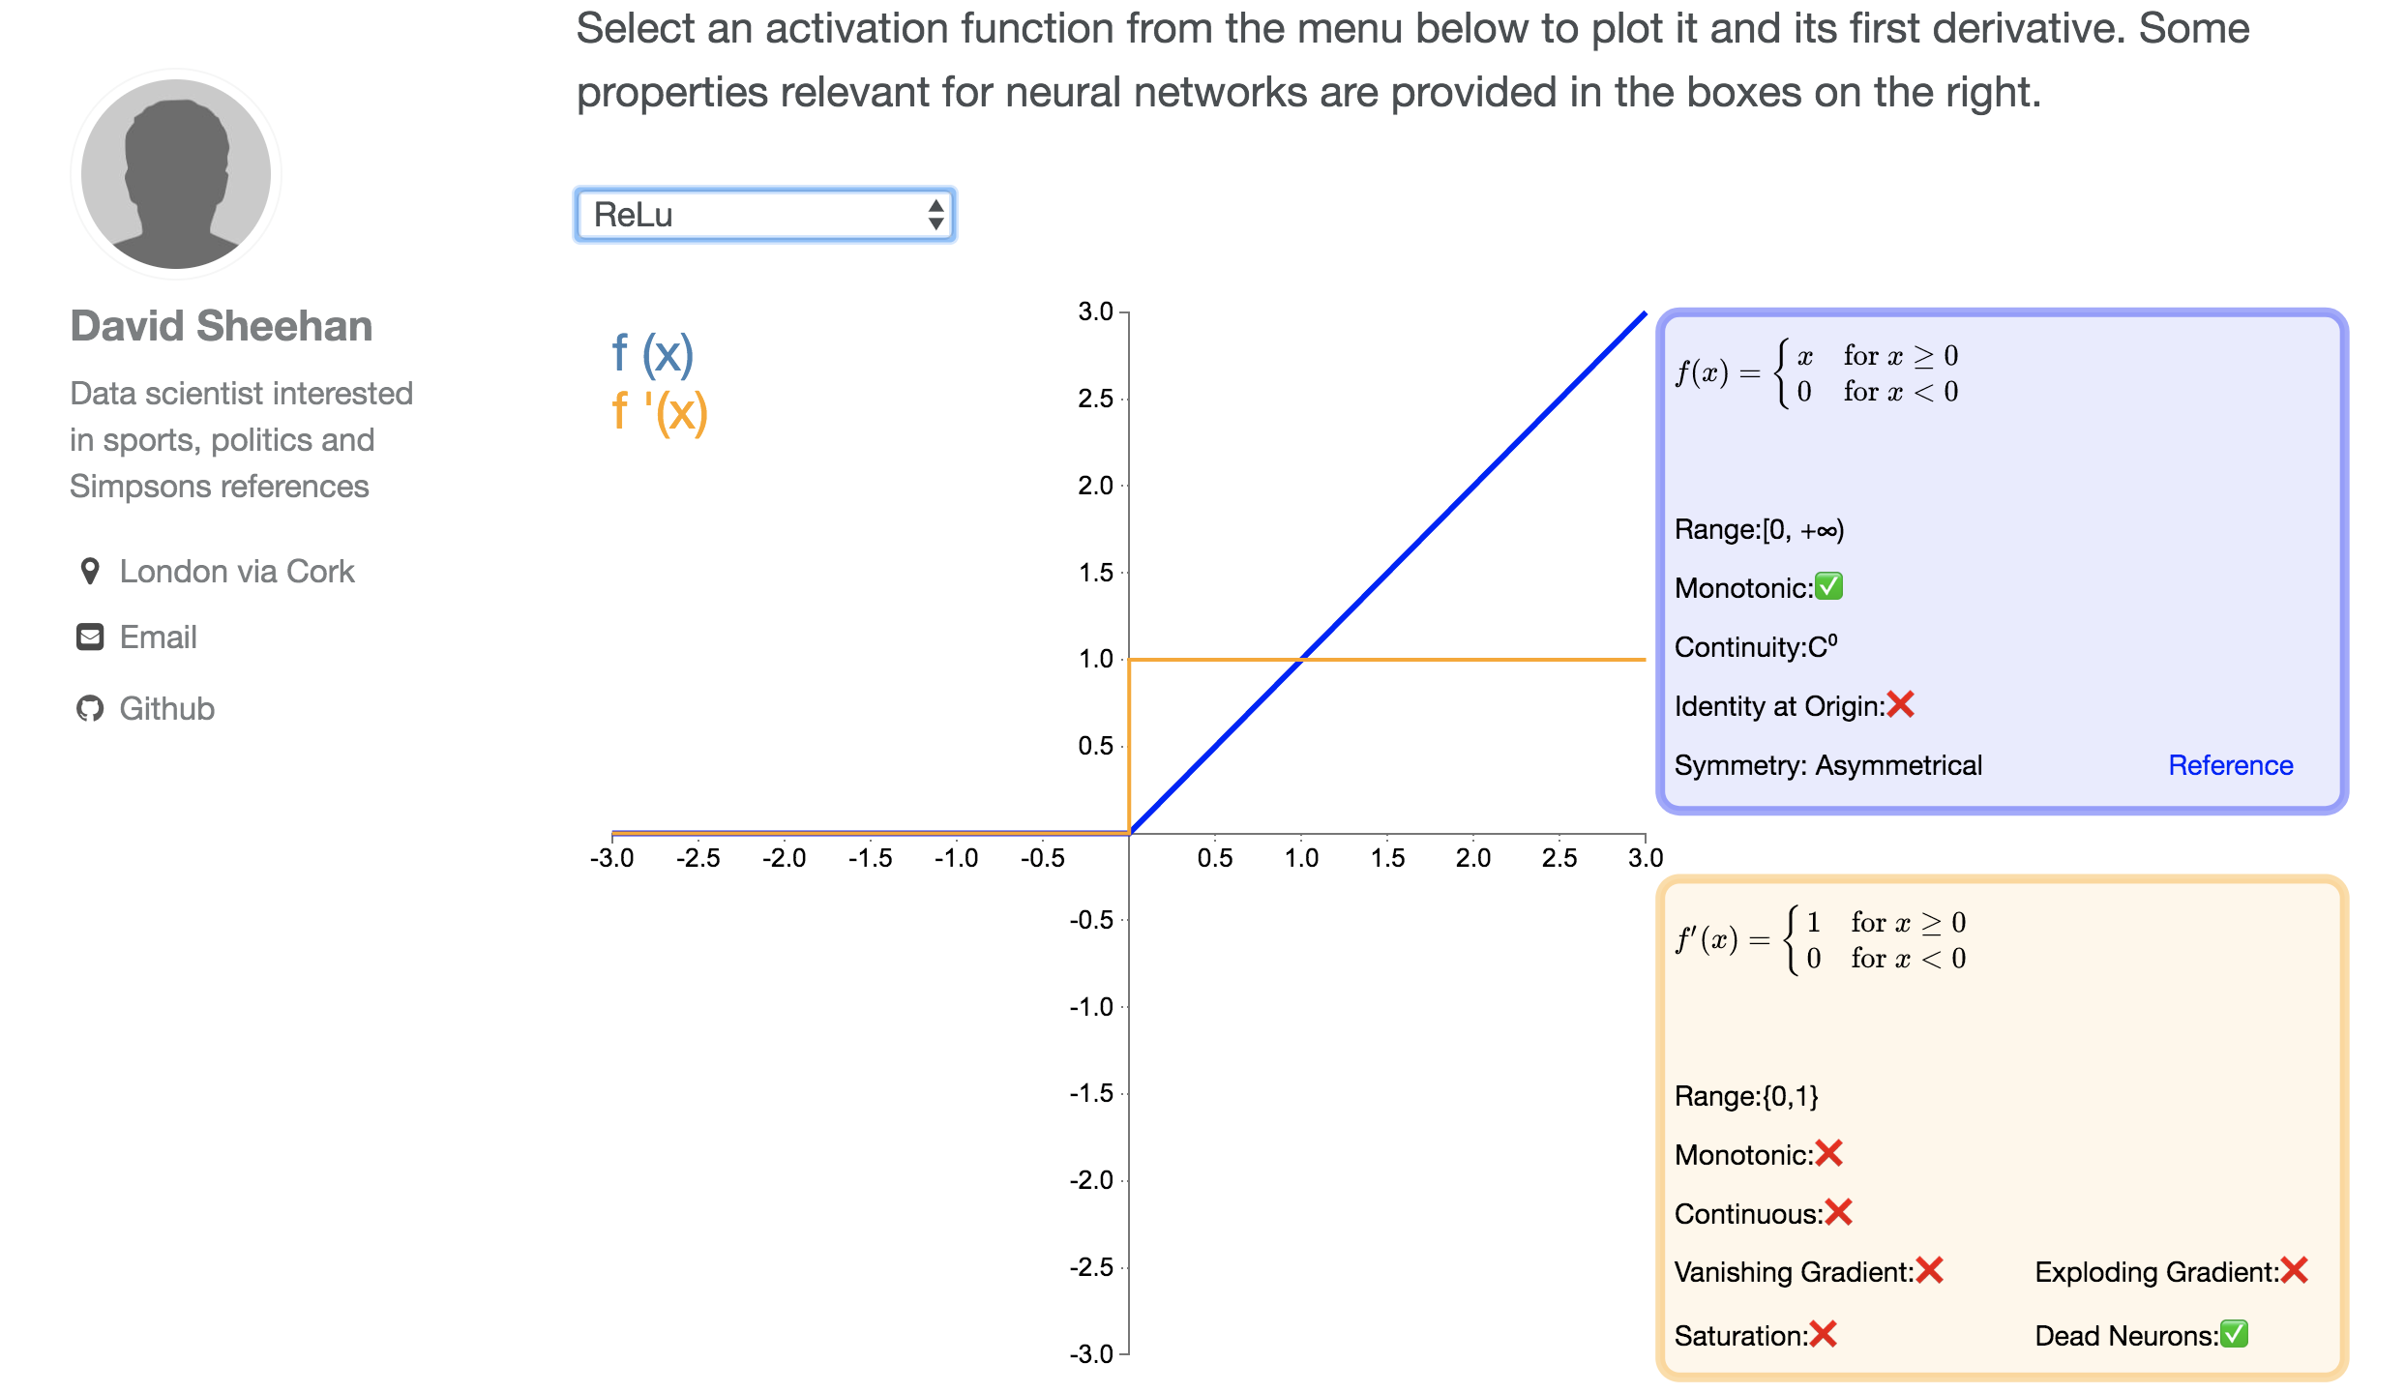
Many Activation Functions
https://dashee87.github.io/data%20science/deep%20learning/visualising-activation-functions-in-neural-networks/

Slide 23


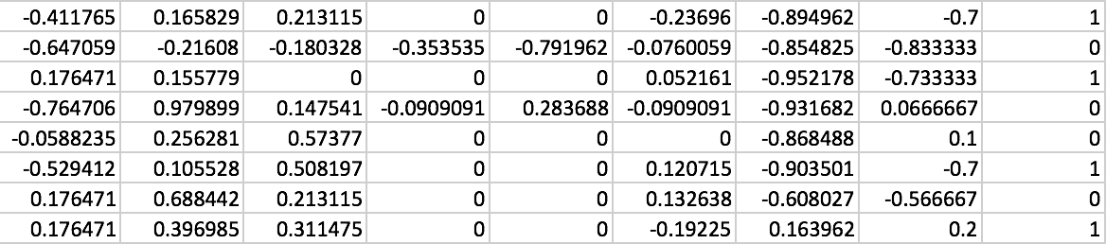
Classifying Diabetes
xy = np.loadtxt('data-diabetes.csv', delimiter=',', dtype=np.float32)
x_data = Variable(torch.from_numpy(xy[:, 0:-1]))
y_data = Variable(torch.from_numpy(xy[:, [-1]]))
print(x_data.data.shape) # torch.Size([759, 8])
print(y_data.data.shape) # torch.Size([759, 1])
Notes:
\hat{y}=x*w+b
loss = \frac{1}{N}\sum_{n=1}^{N} y^{(n)} \log \hat{y}^{(n)} + (1 - y^{(n)}) \log (1-\hat{y}^{(n})

Slide 24
Wide & Deep
class Model(torch.nn.Module):
def __init__(self):
"""
In the constructor we instantiate three nn.Linear module
"""
super(Model, self).__init__()
self.l1 = torch.nn.Linear(8, 6)
self.l2 = torch.nn.Linear(6, 4)
self.l3 = torch.nn.Linear(4, 1)
self.sigmoid = torch.nn.Sigmoid()
def forward(self, x):
"""
In the forward function we accept a Variable of input data and we must return
a Variable of output data. We can use Modules defined in the constructor as
well as arbitrary operators on Variables.
"""
out1 = self.sigmoid(self.l1(x))
out2 = self.sigmoid(self.l2(out1))
y_pred = self.sigmoid(self.l3(out2))
return y_pred
Notes:
\hat{y}=x*w+b
loss = \frac{1}{N}\sum_{n=1}^{N} y^{(n)} \log \hat{y}^{(n)} + (1 - y^{(n)}) \log (1-\hat{y}^{(n})

Slide 25



Classifying Diabetes
xy = np.loadtxt('data-diabetes.csv', delimiter=',', dtype=np.float32)
x_data = Variable(torch.from_numpy(xy[:, 0:-1]))
y_data = Variable(torch.from_numpy(xy[:, [-1]]))
class Model(torch.nn.Module):
def __init__(self):
"""
In the constructor we instantiate two nn.Linear module
"""
super(Model, self).__init__()
self.l1 = torch.nn.Linear(8, 6)
self.l2 = torch.nn.Linear(6, 4)
self.l3 = torch.nn.Linear(4, 1)
self.sigmoid = torch.nn.Sigmoid()
def forward(self, x):
"""
In the forward function we accept a Variable of input data and we must return
a Variable of output data. We can use Modules defined in the constructor as
well as arbitrary operators on Variables.
"""
out1 = self.sigmoid(self.l1(x))
out2 = self.sigmoid(self.l2(out1))
y_pred = self.sigmoid(self.l3(out2))
return y_pred
# our model
model = Model()
# Construct our loss function and an Optimizer. The call to model.parameters()
# in the SGD constructor will contain the learnable parameters of the two
# nn.Linear modules which are members of the model.
criterion = torch.nn.BCELoss(size_average=True)
optimizer = torch.optim.SGD(model.parameters(), lr=0.1)
# Training loop
for epoch in range(100):
# Forward pass: Compute predicted y by passing x to the model
y_pred = model(x_data)
# Compute and print loss
loss = criterion(y_pred, y_data)
print(epoch, loss.data[0])
# Zero gradients, perform a backward pass, and update the weights.
optimizer.zero_grad()
loss.backward()
optimizer.step()
Design your model using class
Construct loss and optimizer
(select from PyTorch API)
Training cycle
(forward, backward, update)
Notes:
\hat{y}=x*w+b
loss = \frac{1}{N}\sum_{n=1}^{N} y^{(n)} \log \hat{y}^{(n)} + (1 - y^{(n)}) \log (1-\hat{y}^{(n})

Slide 26
MNIST dataset size
60,000 training data images
10,000 test data images
28 x 28 grayscale image
With labeled
Very old-school format to download
Most of the frameworks include it
Notes:
\begin{bmatrix}
a_{1} & b_{1} \\
a_{2} & b_{2} \\
a_{3} & b_{3} \\
\hdotsfor{2} \\
a_{n} & b_{n}
\end{bmatrix}
\begin{bmatrix}
w_1 \\ w_2 \\
\end{bmatrix}
=
\begin{bmatrix}
y_{1} \\
y_{2} \\
y_{3} \\
\hdotsfor{1} \\
y_{n}
\end{bmatrix}

Slide 27
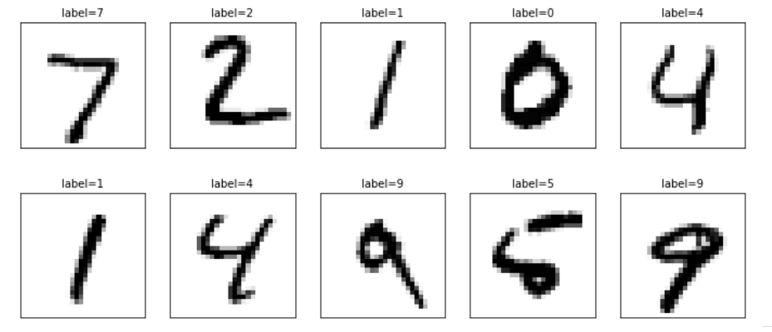
Hand-written digits Hello world of AI
Notes:
\begin{bmatrix}
a_{1} & b_{1} \\
a_{2} & b_{2} \\
a_{3} & b_{3} \\
\hdotsfor{2} \\
a_{n} & b_{n}
\end{bmatrix}
\begin{bmatrix}
w_1 \\ w_2 \\
\end{bmatrix}
=
\begin{bmatrix}
y_{1} \\
y_{2} \\
y_{3} \\
\hdotsfor{1} \\
y_{n}
\end{bmatrix}

Slide 28
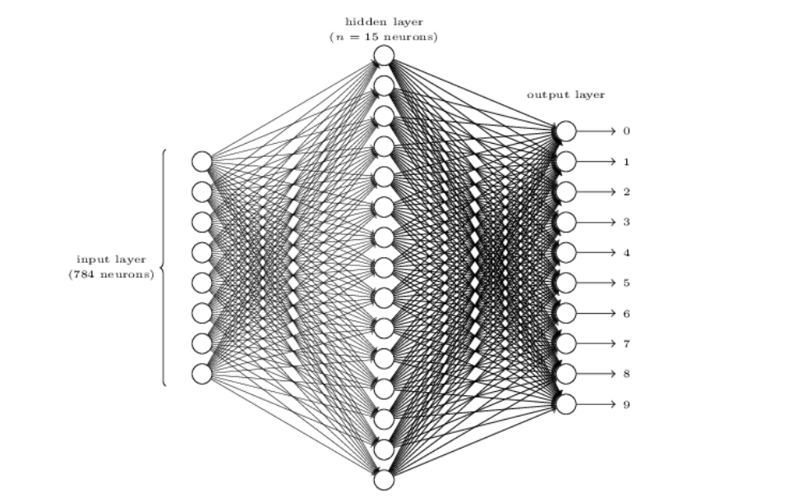
Flatten the 28 x 28 image to a 784 x 1 tensor
Notes:
\begin{bmatrix}
a_{1} & b_{1} \\
a_{2} & b_{2} \\
a_{3} & b_{3} \\
\hdotsfor{2} \\
a_{n} & b_{n}
\end{bmatrix}
\begin{bmatrix}
w_1 \\ w_2 \\
\end{bmatrix}
=
\begin{bmatrix}
y_{1} \\
y_{2} \\
y_{3} \\
\hdotsfor{1} \\
y_{n}
\end{bmatrix}

Slide 29
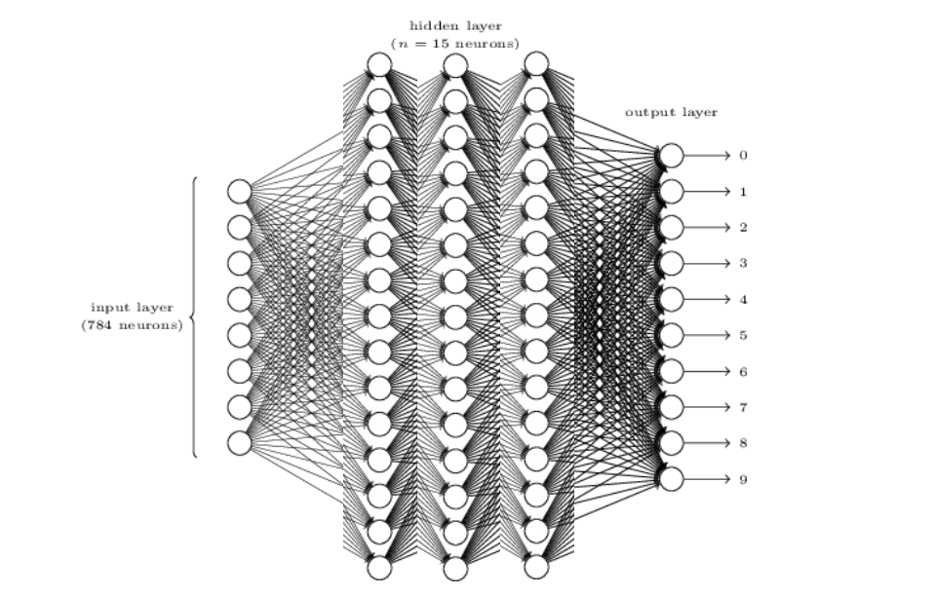
Could be more layers
Notes:
\begin{bmatrix}
a_{1} & b_{1} \\
a_{2} & b_{2} \\
a_{3} & b_{3} \\
\hdotsfor{2} \\
a_{n} & b_{n}
\end{bmatrix}
\begin{bmatrix}
w_1 \\ w_2 \\
\end{bmatrix}
=
\begin{bmatrix}
y_{1} \\
y_{2} \\
y_{3} \\
\hdotsfor{1} \\
y_{n}
\end{bmatrix}

Slide 30
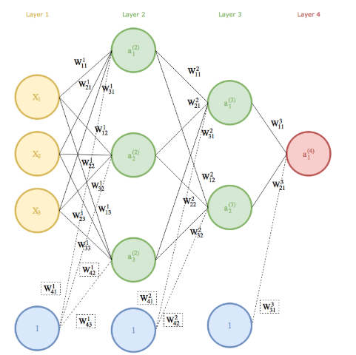
So many weights and biases
Notes:
\begin{bmatrix}
a_{1} & b_{1} \\
a_{2} & b_{2} \\
a_{3} & b_{3} \\
\hdotsfor{2} \\
a_{n} & b_{n}
\end{bmatrix}
\begin{bmatrix}
w_1 \\ w_2 \\
\end{bmatrix}
=
\begin{bmatrix}
y_{1} \\
y_{2} \\
y_{3} \\
\hdotsfor{1} \\
y_{n}
\end{bmatrix}

Slide 31
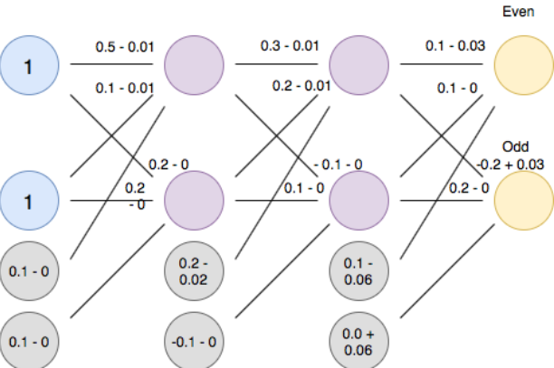
So many graidents to calculate
Notes:
\begin{bmatrix}
a_{1} & b_{1} \\
a_{2} & b_{2} \\
a_{3} & b_{3} \\
\hdotsfor{2} \\
a_{n} & b_{n}
\end{bmatrix}
\begin{bmatrix}
w_1 \\ w_2 \\
\end{bmatrix}
=
\begin{bmatrix}
y_{1} \\
y_{2} \\
y_{3} \\
\hdotsfor{1} \\
y_{n}
\end{bmatrix}

